Slide 1
Computer network session 11
NETWORK SECURITY
Santoso Budijono

Slide 2
Learning outcomes
LO 1: Describe basic structures of network
LO 2: Explain basic concepts of network
LO 3: Design network environment using TCP/IP Model

Slide 3
topics
Security Goals
Threat, Attacks
Cryptography concept
Security in Cloud computing

Slide 4
NETWORK SECURITY
DEFINITION
Security is a state of well-being of information and infrastructures in which the possibility of successful yet undetected theft, tampering, and disruption of information and services is kept low or tolerable.
Security rests on confidentiality, authenticity, integrity, and availability.

Slide 5
NETWORK SECURITY
SECURITY GOAL
Confidentiality :
ensures that sensitive information is accessible only to those who are authorized to view it. This is crucial for protecting personal data, proprietary information, and other confidential materials from unauthorized access and breaches
Confidentiality
Integrity
Availability
Availability :
Ensures that information and resources are accessible to authorized users whenever they need them. This involves maintaining the uptime and performance of systems, ensuring there is sufficient bandwidth, and protecting against disruptions such as hardware failures, cyber-attacks, or natural disasters
integrity
ensures that information remains accurate, consistent, and unaltered except by authorized users.

Slide 6
NETWORK SECURITY
THREAT & ATTACKS
A threat is a potential violation of security.
  Flaws in design, implementation, and operation.
An attack is any action that violates security.
  Active adversary.
Common threats:
  Snooping/eavesdropping, alteration, spoofing, repudiation of origin, denial of receipt, delay and denial of service.

Slide 7
NETWORK SECURITY
ATTACKS CLASSIFICATION
Passive Attacks
  System unaltered, hard to detect.
  Eavesdropping on, or monitoring of, transmissions to:
    obtain message contents, or
    monitor traffic flows.
Active Attacks .
  System altered, easier to detect.
  Modification of data stream to:
    masquerade of one entity as some other.
    replay previous messages.
    modify messages in transit.
    denial of service.

Slide 8
NETWORK SECURITY
IMPACT OF ATTACKS
Theft of confidential information.
Unauthorized use of
  Network bandwidth.
  Computing resource.
Spread of false information.
Disruption of legitimate services.
All attacks can be related and are dangerous!

Slide 9
NETWORK SECURITY
METHODS OF DEFENCE
Information Protection
  Encryption.
Software Controls
  Access limitations in a data base.
  In operating system protect each user from other users.
Hardware Controls
  Smartcard, biometric.
Policies
  Frequent changes of passwords.
Physical Controls

Slide 10
NETWORK SECURITY
CRYPTOGRAPHY
Study of encryption principles/methods characterized by:
    Number of keys used.
      Single-key or secret key.
      Two-key or public key.
    Type of encryption operations used
      Substitution.
      Transposition.
      Product .
    Way in which plaintext is processed
      Block.
      Stream.

Slide 11
NETWORK SECURITY
ENCRYPTION OVERVIEW
Insecure Channel
Plaintext
Encrypt
Ciphertext
Decrypt
Plaintext
P
P = D(C)
C = E(P)

Slide 12
NETWORK SECURITY
Symmetric key / one KEY CRYPTOGRAPHY
The parties communicating share a completely random and secret key.
Key is not known to an opponent.
  Must be shared securely by the communicating parties.
  Must be completely random.
  Must be kept completely secret from the oppenents.
All classical cryptosystems are private-key based.
Traditionally symmetric encryption is used to. provide message confidentiality.
Can also be used for secure storage.

Slide 13
NETWORK SECURITY
Symmetric key ENCRYPTION
An encryption scheme has five ingredients:
  Plaintext.
  Encryption algorithm.
  Secret Key.
  Ciphertext.
  Decryption algorithm.
Security depends on the secrecy of the key, not the secrecy of the algorithm.

Slide 14
NETWORK SECURITY
Asymmetric key, public/private KEY CRYPTOGRAPHY
Public-key/two-key/asymmetric cryptography involves the use of two keys:
  Public-key, which may be known by anybody.
  Private-key, known only to the recipient.
Complements rather than replaces private key cryptography.
Public key cryptography enhances the security as it enables authentication, integrity, non-repudiation besides confidentiality.
Ingredients: Plain text, Encryption algorithm, Public and private key, Cipher text, Decryption algorithm.
If one key is used for encryption, the other for decryption.

Slide 15
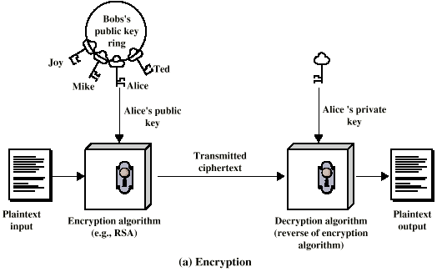
NETWORK SECURITY
Asymmetric key, public/private KEY CRYPTOGRAPHY

Slide 16
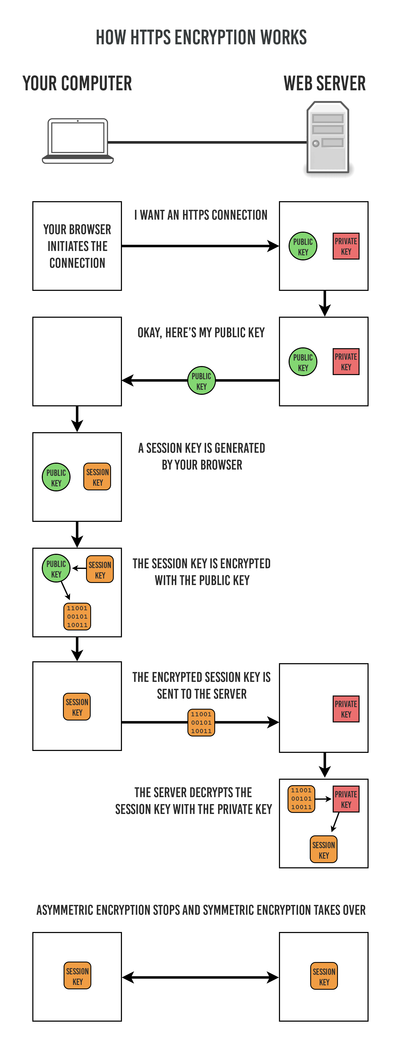
Network security
https encryption works
https://stackoverflow.com/questions/71935651/how-does-fiddler-decrypt-https-traffic-it-works-for-my-iphone-but-fails-for-my
Notes:
Please see website : encryption - How does Fiddler decrypt https traffic? It works for my iPhone but fails for my Android - Stack Overflow

Slide 17
Exercise
Explain security applied to secure browsing process between Sender (PC) to Server? (Using concept symmetric and asymmetric)

Slide 18
REFFERENCE
Forouzan, B. A. (2021). Data Communications and Networking with TCP/IP Protocol Suite. 6th Ed. New York: McGraw-Hill. ISBN: 978-1-26-436335-3. Chapter 13

Slide 19
Thank you
December 2024

